Slide 1


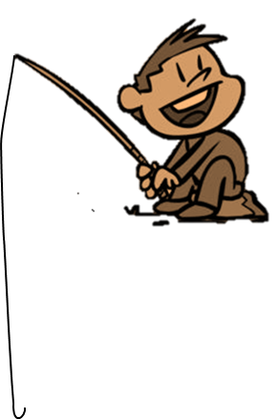
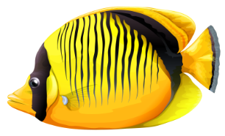
FISHING GAME
GO

Slide 2


Question 1?
C.right
A.wrong
D.wrong
C.right
B.wrong

Slide 3
Question 2?
D.right
A.wrong
B.wrong
C.wrong
D.right

Slide 4
Question 3?
A.right
A.right
D.wrong
C.wrong
B.wrong

Slide 5
Question 4?
D.right
A.wrong
B.wrong
C.wrong
D.right

Slide 6
Question 5?
C.right
A.wrong
D.wrong
C.right
B.wrong

Slide 7
Question 6?
A.right
A.right
D.wrong
C.wrong
B.wrong

Slide 8
Question 7?
D.right
A.wrong
B.wrong
C.wrong
D.right

Slide 9
Question 8?
A.right
A.right
D.wrong
B.wrong
C.wrong

Slide 10
Question 9?
B.right
B.right
A.wrong
D.wrong
C.wrong

Slide 11
Question 10?
C.right
A.wrong
D.wrong
C.right
B.wrong

Slide 12

Subscribe my channel, please

